Slide 1
Appointment Overview & Treatment Details
Pharmacy Aesthetics

Slide 2
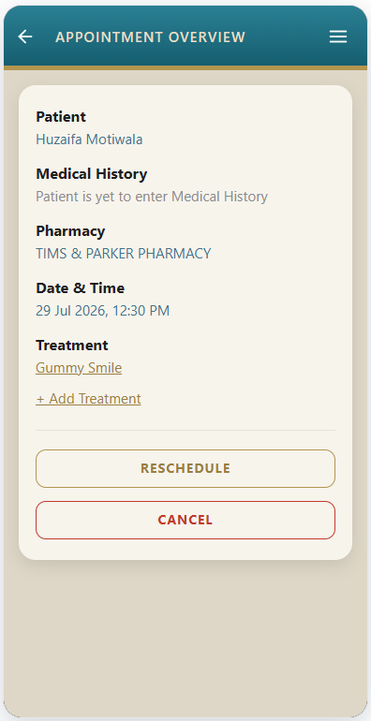
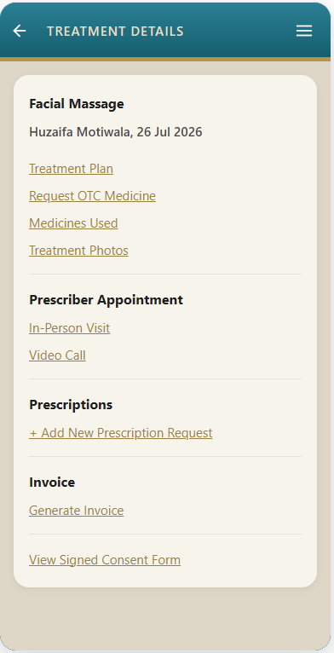
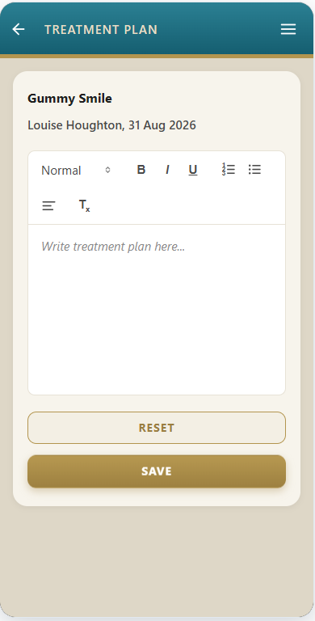
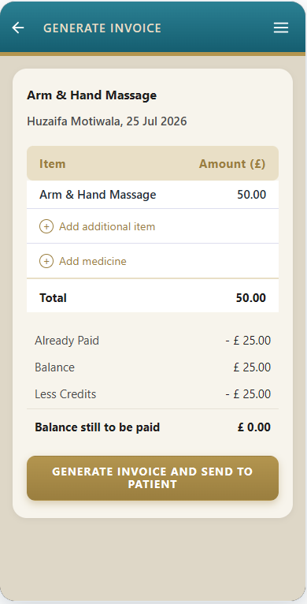
Practitioner Module
In the Practitioner module, the Appointment Overview page will have all these values (as indicated by red box)
Patient
Medical History
Pharmacy
Date & Time
Treatment
However, on the Treatment Details page we will not repeat all the details shown on the Appointment Overview. Instead, we will just show the treatment name, patient name and date (as indicated in the red box)
Even the pages within Treatment Details, for e.g. Treatment Plan, Generate Invoice, etc, we will just show the treatment name, patient name and date (as indicated in the red box).

Slide 3
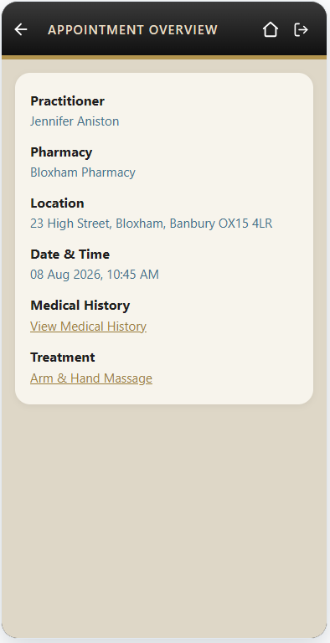
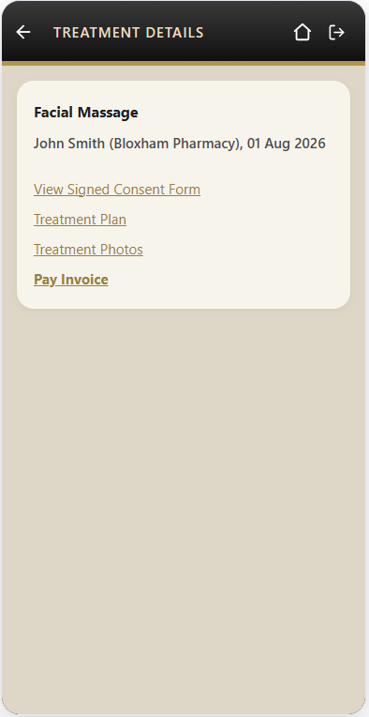
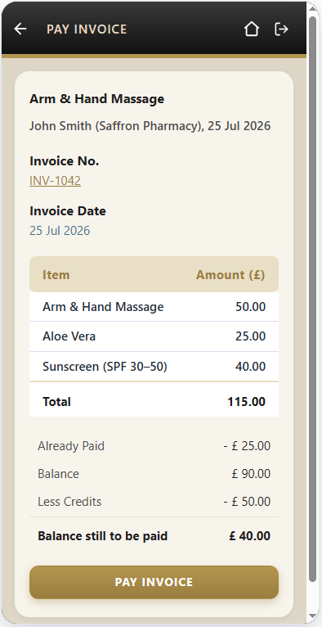
Patient Module
In the Patient module also, the Appointment Overview page will have all these values (as indicated by red box)
Practitioner
Pharmacy
Location
Date & Time
Medical History
Treatment
However, on the Treatment Details page we will not repeat all the details shown on the Appointment Overview. Instead, (just like in the Practitioner module) we will just show the treatment name, practitioner name, pharmacy name, and date (as indicated in the red box)
Even the pages within Treatment Details, for e.g. Pay Invoice, we will just show the treatment name, practitioner name, pharmacy name, and date (as indicated in the red box).

