Slide 1
Button Standardization
Pharmacy Aesthetics

Slide 2
Different types of buttons in the project

Slide 3

1. Primary Button
https://specs.pharmacyaesthetics.com/Pharmacy_Wireframes/Pharmacy_Wireframes_Website/home.html
The “Book Appointment” button over here on the homepage is the perfect example of a primary button.
Pl use the css of this button for all primary buttons across the project. This includes everything – font family, weight, case, letter-spacing, line-height, color, background color, border, border radius, etc.
Only property flexible here is the width of the button which will depend on where it is being displayed.

Slide 4
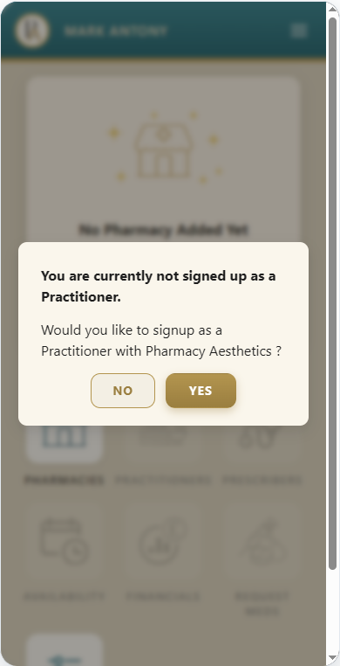
“Yes/No” Button in alerts/warning
https://specs.pharmacyaesthetics.com/Pharmacy_Wireframes/Pharmacy_Wireframes_Website/partner-owner-dashboard-signup-popup.html
The “Yes/No” buttons over here on this page are the perfect example of such buttons. All buttons on alerts should follow this.
Pl use the css of this button for all such buttons across the project. This includes everything – font family, weight, case, letter-spacing, line-height, color, background color, border, border radius, etc.
Note – All alert buttons should typically be only “Yes/No” rather than “Confirm/Cancel” which can clash with the “confirmation” and “cancelation” of an appointment. Hence the question in the alert should also always be framed in such a way that it only has a Yes/No answer.

Slide 5
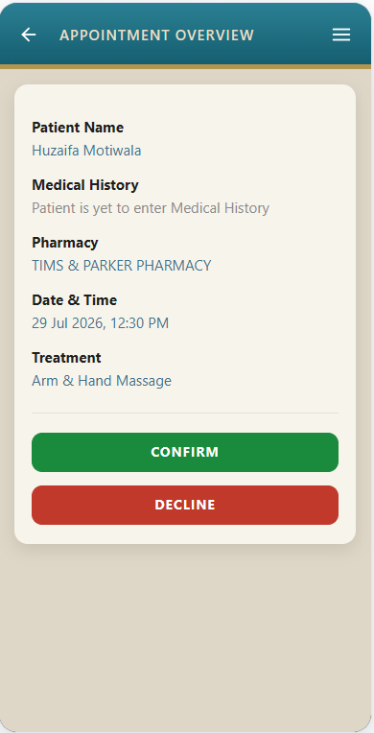
“Confirm/Decline” Button
https://specs.pharmacyaesthetics.com/Pharmacy_Wireframes/Pharmacy_Wireframes_Website/partner-practitioner-appointment-overview.html
The “Confirm/Decline” buttons over here on this page are the perfect example of such buttons.
Pl use the css of this button for all such buttons across the project. This includes everything – font family, weight, case, letter-spacing, line-height, color, background color, border, border radius, etc.
Philosophy – These are all primary buttons but since they are two, it is important to separate their colors as per their meaning – hence green and red.

Slide 6
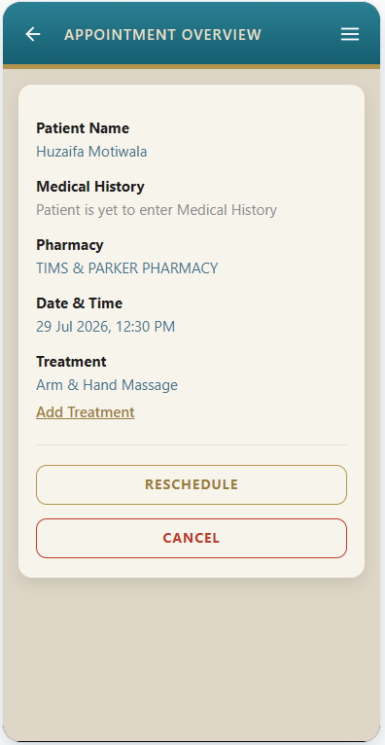
“Reschedule/Cancel” Button
https://specs.pharmacyaesthetics.com/Pharmacy_Wireframes/Pharmacy_Wireframes_Website/partner-practitioner-appointment-overview-confirmed-yet-to-enter-medical-history.html
The “Reschedule/Cancel” buttons over here on this page are the perfect example of such buttons.
Pl use the css of this button for all such buttons across the project. This includes everything – font family, weight, case, letter-spacing, line-height, color, background color, border, border radius, etc.
Philosophy – These are not primary buttons, in the sense, the user has does not compulsorily need to reschedule or cancel. Hence, these buttons are kept subtle by not having a background color.

Slide 7
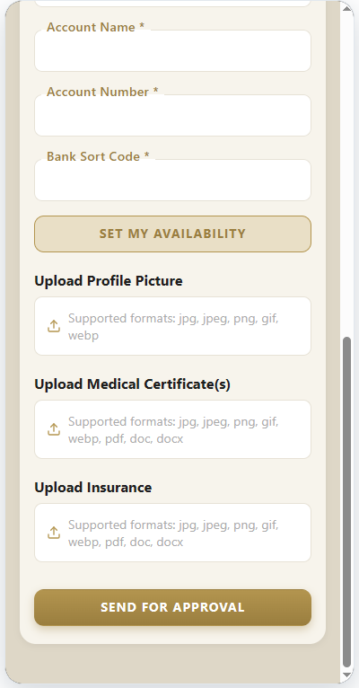
“Availability” Button
https://specs.pharmacyaesthetics.com/Pharmacy_Wireframes/Pharmacy_Wireframes_Website/partner-prescriber-signup.html
The “Set My Availability” button over here on this page is the perfect example of such buttons.
This button exists on all these pages with slightly different wording:
"SET MY AVAILABILITY" in "Signup form - Prescriber"
"SET PHARMACY TIMINGS" in "Pharmacy Owner > Add Pharmacy"
"VIEW SCHEDULE" in "Pharmacy Owner > View Pharmacy"
"SET MY AVAILABILITY" in "Practitioner > Setting Availability at Pharmacy"
Pl use the css of this button for all such buttons across the project. This includes everything – font family, weight, case, letter-spacing, line-height, color, background color, border, border radius, etc.
Philosophy – These are important buttons but since they always tend to appear near a primary button, their look is made a little different by changing the background color.

Slide 8
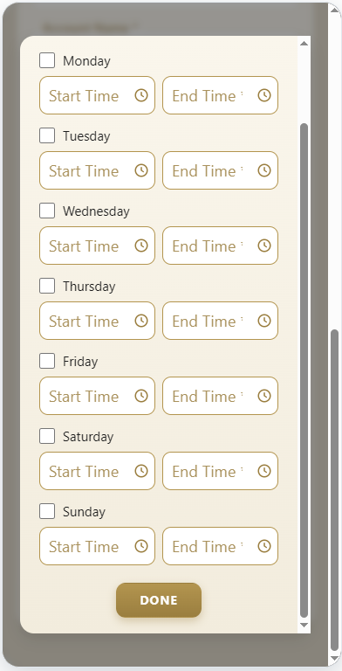
“Done” Button on “Availability” popup
https://specs.pharmacyaesthetics.com/Pharmacy_Wireframes/Pharmacy_Wireframes_Website/partner-prescriber-signup.html
The “Done” button over here on this page is the perfect example of such buttons.
This button exists on the “availability” popups of all these pages:
"SET MY AVAILABILITY" in "Signup form - Prescriber"
"SET PHARMACY TIMINGS" in "Pharmacy Owner > Add Pharmacy"
"VIEW SCHEDULE" in "Pharmacy Owner > View Pharmacy"
"SET MY AVAILABILITY" in "Practitioner > Setting Availability at Pharmacy"
Pl use the css of this button for all such buttons across the project. This includes everything – font family, weight, case, letter-spacing, line-height, color, background color, border, border radius, etc.

Slide 9
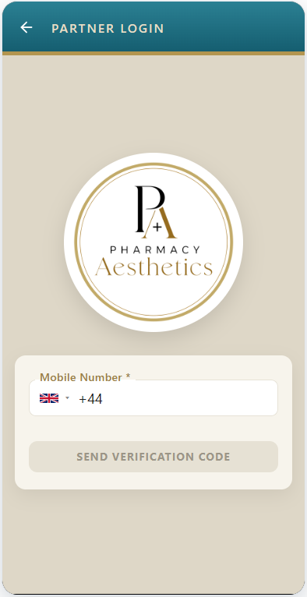
“Disabled” Button
https://specs.pharmacyaesthetics.com/Pharmacy_Wireframes/Pharmacy_Wireframes_Website/partner-owner-login.html
The disabled button over here on this page is the perfect example of such buttons.
Pl use the css of this button for all such buttons across the project. This includes everything – font family, weight, case, letter-spacing, line-height, color, background color, border, border radius, etc.

Slide 10
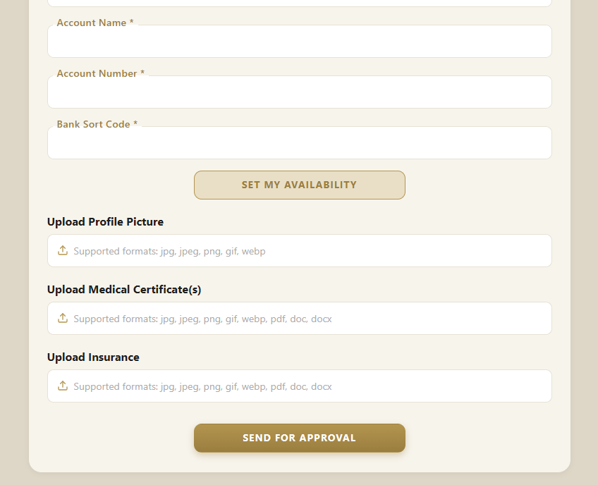
Primary Button width in mobile when there is a single button
The primary button (that appears at the bottom of the page) on mobile will extend to full width, as shown here.
Primary Button width in desktop when there is a single button
The primary button (that appears at the bottom of the page) on desktop will be center-aligned and will have a fixed max-width of 300px
(Except in some instances, given on the next slide)

Slide 11
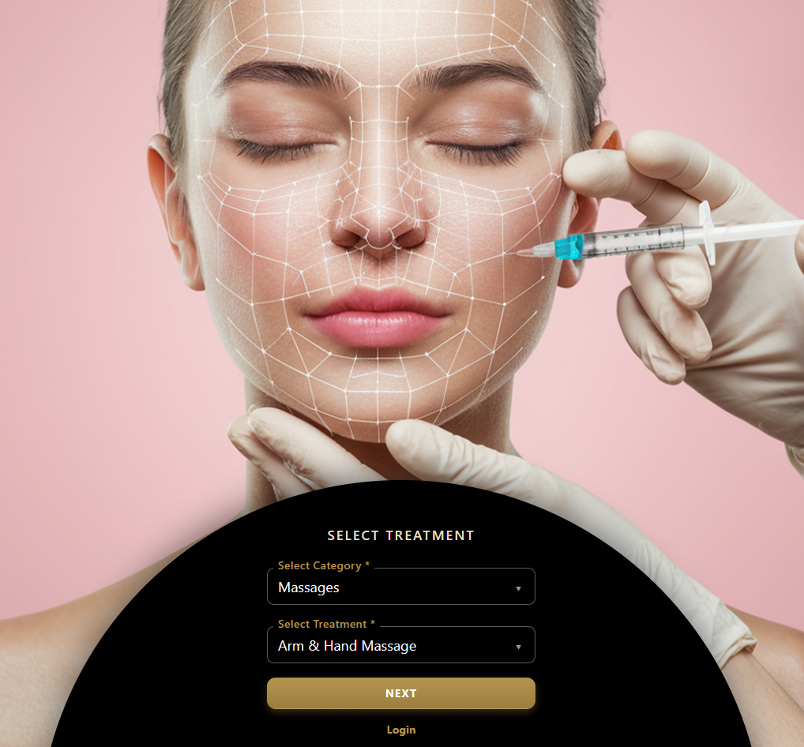

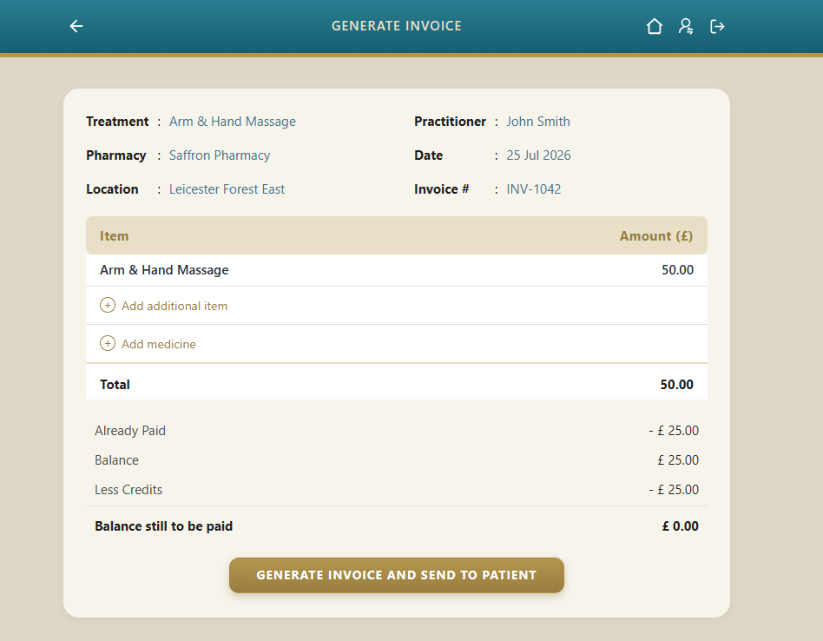
Primary Button width in desktop where the max-width will not be 300px (in case of single button)
Here the primary button is more than 300 px so as to accommodate the increased text in the button
Here the primary button is more than 300 px so as to make it the same width as the controls above

Slide 12
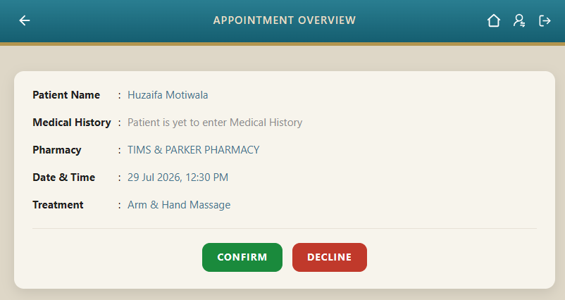
Primary Buttons in mobile when there are multiple buttons
The primary buttons (that appear at the bottom of the page) on mobile will extend to full width and will stack one on top of another
Primary Buttons in desktop when there are multiple buttons
The primary buttons (that appears at the bottom of the page) on desktop will appear side-by-side and will take the width of their text content

