Slide 1
Fonts
Pharmacy Aesthetics

Slide 2
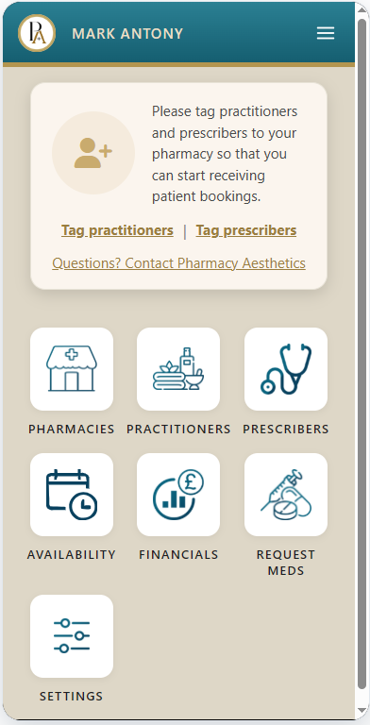
HEADER TEXT
This is the perfect example of the header text. This look should be constant across the site (partner pages and patient pages)
https://specs.pharmacyaesthetics.com/Pharmacy_Wireframes/Pharmacy_Wireframes_Website/partner-owner-dashboard-approved-no-partners.html

Slide 3
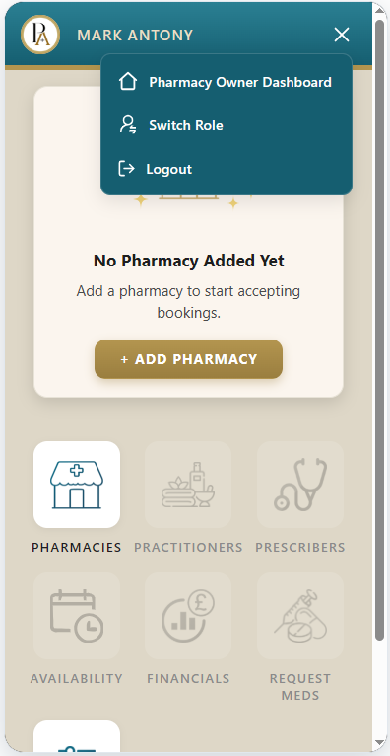
RESPONSIVE MENU
This is how the text and icons in the Responsive menu should appear
https://specs.pharmacyaesthetics.com/Pharmacy_Wireframes/Pharmacy_Wireframes_Website/partner-owner-dashboard-responsive-menu.html

Slide 4

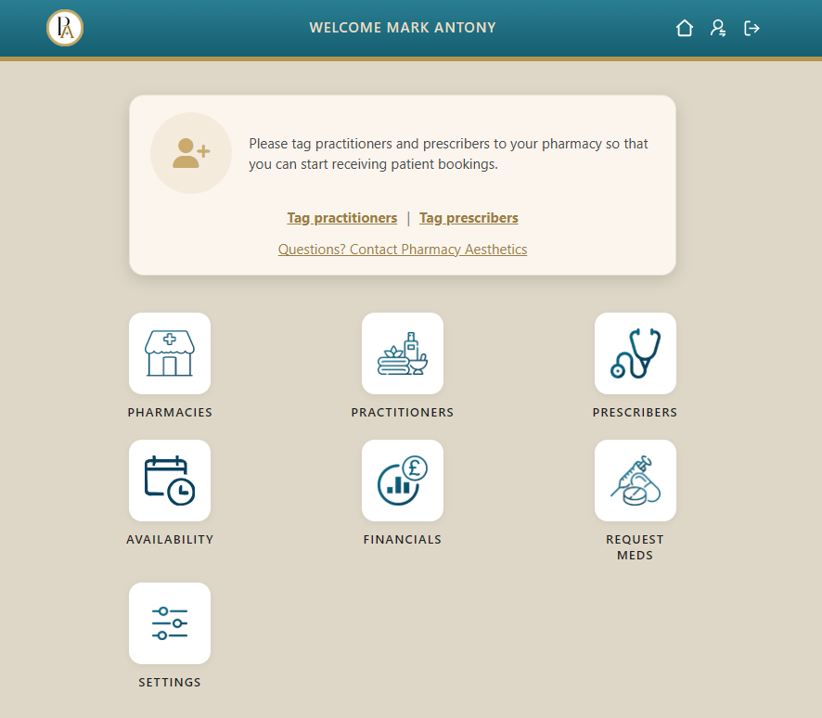
DASHBOARD ALERT - WIDTH
This shall be the width of the Dashboard alert on both mobile and desktop.
Also, note the rounded corners.
The look of the Dashboard alerts should be consistent across the project – all partner dashboards and patient dashboard.
https://specs.pharmacyaesthetics.com/Pharmacy_Wireframes/Pharmacy_Wireframes_Website/partner-owner-dashboard-approved-no-partners.html
https://specs.pharmacyaesthetics.com/Pharmacy_Wireframes/Pharmacy_Wireframes_Website/partner-owner-dashboard-approved-no-partners.html

Slide 5
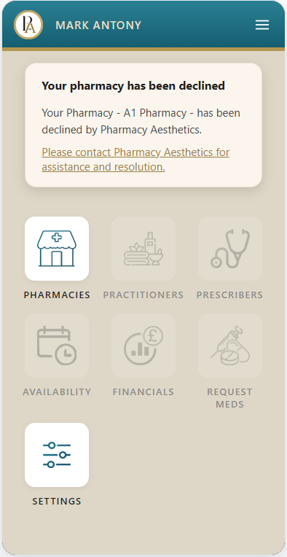
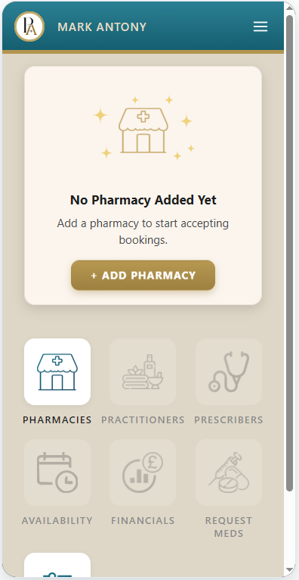
https://specs.pharmacyaesthetics.com/Pharmacy_Wireframes/Pharmacy_Wireframes_Website/partner-owner-dashboard-responsive-menu.html
DASHBOARD ALERT - FONTS
This is the perfect example of bold text in a dashboard alert.
This is the perfect example of running text in a dashboard alert
This is also the same look for running text across the website
This is the perfect example of a regular link in a dashboard alert.
This is also the same look for a regular link across the website
https://specs.pharmacyaesthetics.com/Pharmacy_Wireframes/Pharmacy_Wireframes_Website/partner-owner-dashboard-pharmacy-declined.html
Only special case where bold text has font-size: 17px (larger than the usual 16px shown on the left screen)
The look of the text in the Dashboard alerts should be consistent across the project – all partner dashboards and patient dashboard.

Slide 6
DASHBOARD ALERT – FONTS (CALL-TO-ACTION LINK)
This is the perfect example of a call-to-action link in a dashboard alert. It is bolder than normal.
This is also the same look for a call-to-action link across the website
The look of the call-to-action links in the Dashboard alerts should be consistent across the project – all partner dashboards and patient dashboard.
https://specs.pharmacyaesthetics.com/Pharmacy_Wireframes/Pharmacy_Wireframes_Website/partner-owner-dashboard-approved-no-partners.html

Slide 7
DASHBOARD ICON TEXT
This is the perfect example of the icon text.
This look should be constant across the site (all partner dashboards and patient dashboard)
https://specs.pharmacyaesthetics.com/Pharmacy_Wireframes/Pharmacy_Wireframes_Website/partner-owner-dashboard-approved-no-partners.html

Slide 8
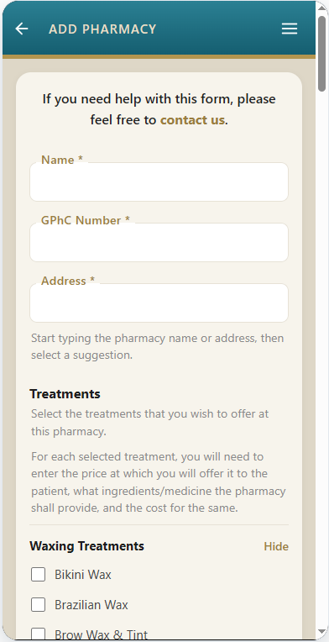
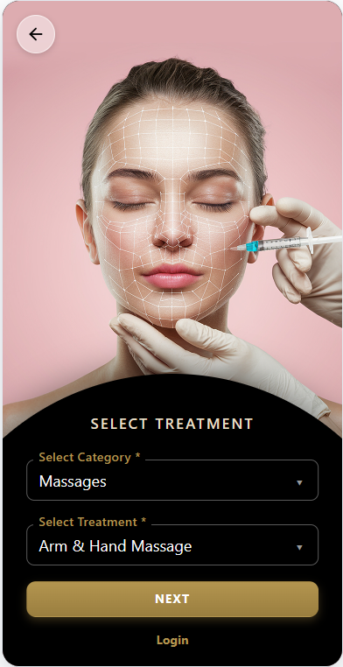
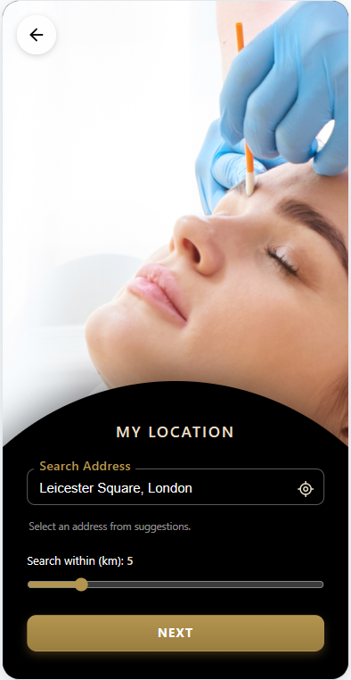
FIELD LABELS
This is how the Field Label should appear on all pages, in terms of font, boldness, size, color, letter-spacing, etc.
Only on the pages shown here on the right, do the field labels appear slightly differently (due the to background and the overall page layout of these pages)
https://specs.pharmacyaesthetics.com/Pharmacy_Wireframes/Pharmacy_Wireframes_Website/add-pharmacy.html

Slide 9
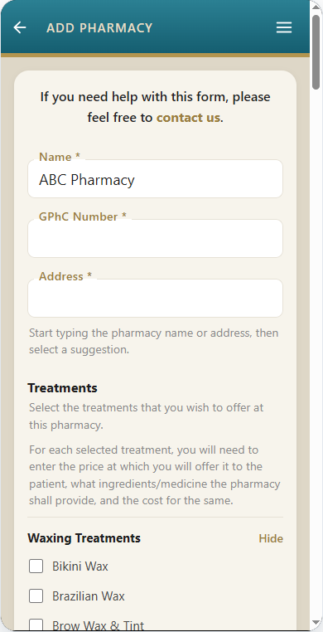
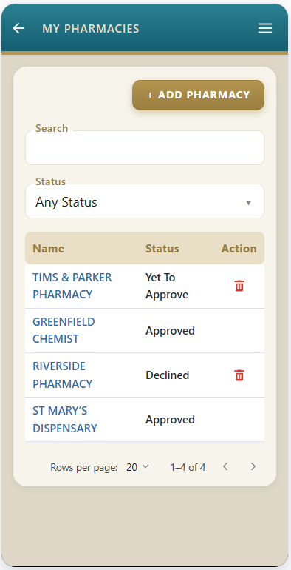
TEXTBOX & DROPDOWN
This is how the textbox and dropdown should appear on all pages (in terms of height, border-radius, font size, font, etc)
Width of the textbox and dropdown shall be kept flexible depending on the layout of the page where it appears.
Only exception for textbox and dropdown appearance are the below pages.
https://specs.pharmacyaesthetics.com/Pharmacy_Wireframes/Pharmacy_Wireframes_Website/partner-owner-pharmacies.html
https://specs.pharmacyaesthetics.com/Pharmacy_Wireframes/Pharmacy_Wireframes_Website/add-pharmacy.html

Slide 10
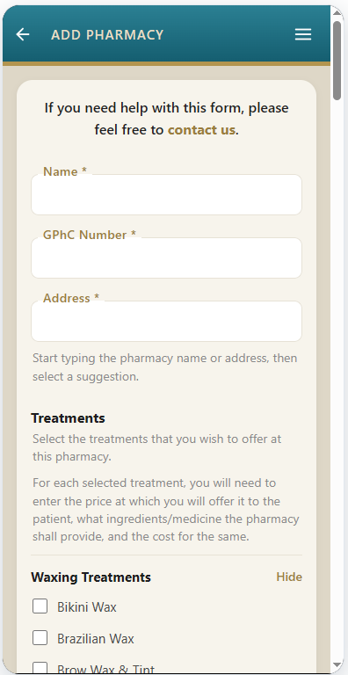
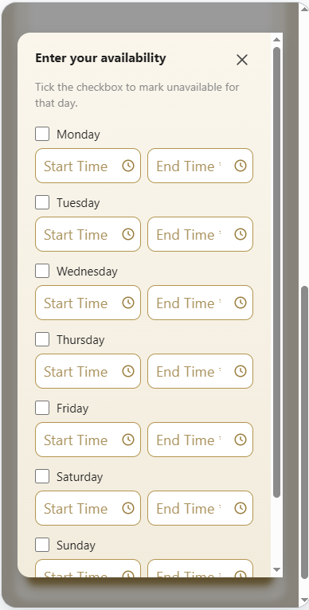
EXPLANATORY TEXT
This is how the explanatory text should appear on the website.
https://specs.pharmacyaesthetics.com/Pharmacy_Wireframes/Pharmacy_Wireframes_Website/partner-prescriber-signup.html
https://specs.pharmacyaesthetics.com/Pharmacy_Wireframes/Pharmacy_Wireframes_Website/add-pharmacy.html

Slide 11
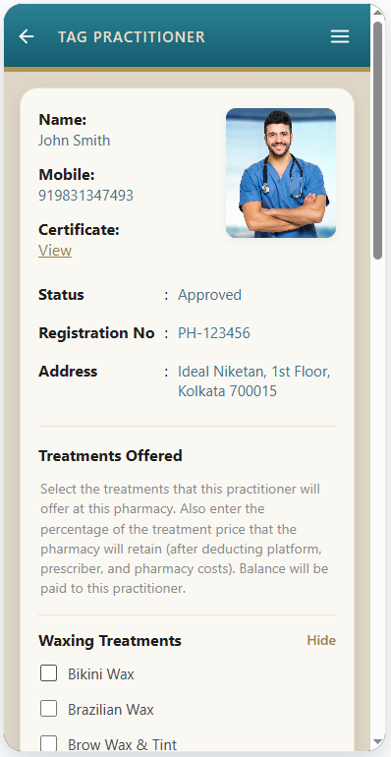
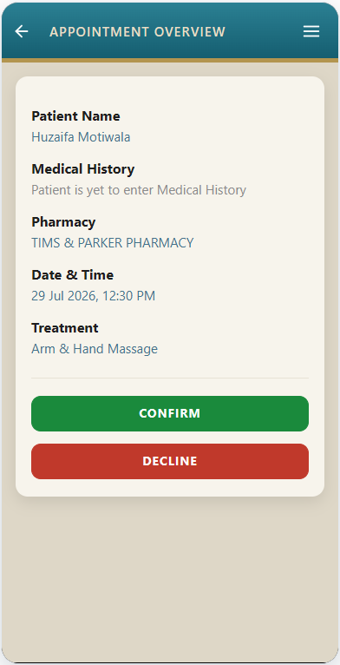
LABELS, SECTION SEPARATORS
This is how the labels and section separators should appear across the website
https://specs.pharmacyaesthetics.com/Pharmacy_Wireframes/Pharmacy_Wireframes_Website/partner-practitioner-appointment-overview.html
https://specs.pharmacyaesthetics.com/Pharmacy_Wireframes/Pharmacy_Wireframes_Website/partner-owner-tag-practitioner.html

Slide 12
VALUES
This is how the values should appear across the website
https://specs.pharmacyaesthetics.com/Pharmacy_Wireframes/Pharmacy_Wireframes_Website/partner-practitioner-appointment-overview.html
https://specs.pharmacyaesthetics.com/Pharmacy_Wireframes/Pharmacy_Wireframes_Website/partner-owner-tag-practitioner.html

Slide 13
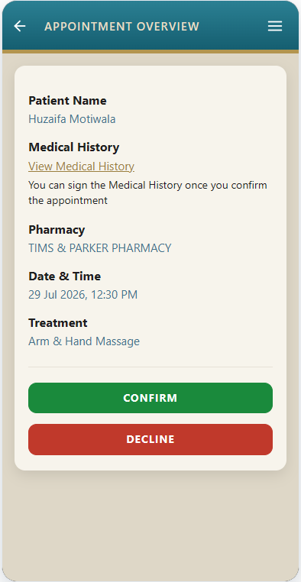
NON CALL-TO-ACTION LINK
This is how a non call-to-action link should appear across the website
https://specs.pharmacyaesthetics.com/Pharmacy_Wireframes/Pharmacy_Wireframes_Website/partner-practitioner-appointment-overview.html
https://specs.pharmacyaesthetics.com/Pharmacy_Wireframes/Pharmacy_Wireframes_Website/partner-owner-tag-practitioner.html

Slide 14
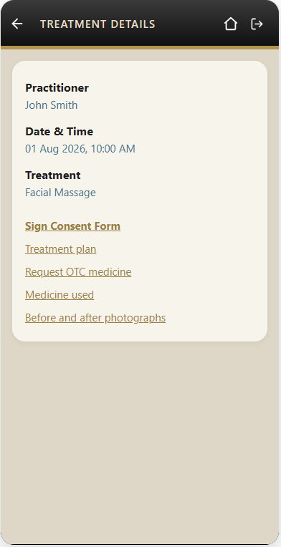
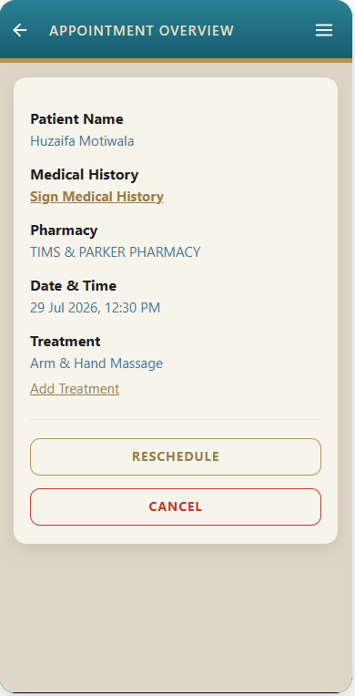
CALL-TO-ACTION LINK
This is how a call-to-action link should appear across the website
These are non call-to-action links
https://specs.pharmacyaesthetics.com/Pharmacy_Wireframes/Pharmacy_Wireframes_Website/partner-practitioner-appointment-overview-sign-medical-history.html
https://specs.pharmacyaesthetics.com/Pharmacy_Wireframes/Pharmacy_Wireframes_Website/patient-treatment-details.html

Slide 15
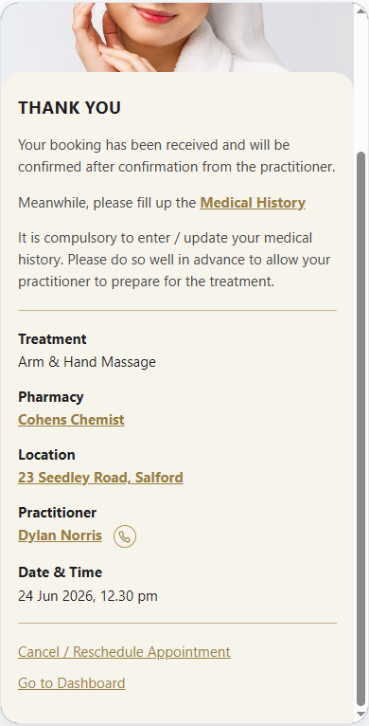
IMPORTANT INFORMATION LINK
This is how link carrying important information should appear across the website
https://specs.pharmacyaesthetics.com/Pharmacy_Wireframes/Pharmacy_Wireframes_Website/confirmation.html
Normal links shall continue to appear like this

Slide 16
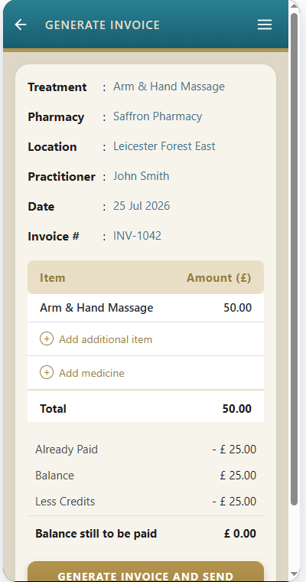
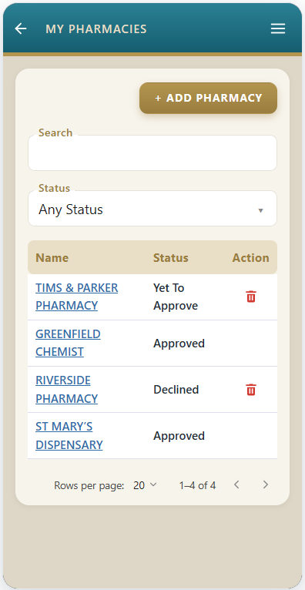
TABLE
The content within a table should appear exactly as over here. By this mean we mean text in the table headers, text in the table rows, links in the table, text in the footer of the table, etc.
However note – In these “list” tables, the links shall be in blue.
https://specs.pharmacyaesthetics.com/Pharmacy_Wireframes/Pharmacy_Wireframes_Website/partner-owner-pharmacies.html
https://specs.pharmacyaesthetics.com/Pharmacy_Wireframes/Pharmacy_Wireframes_Website/invoice.html

Slide 17
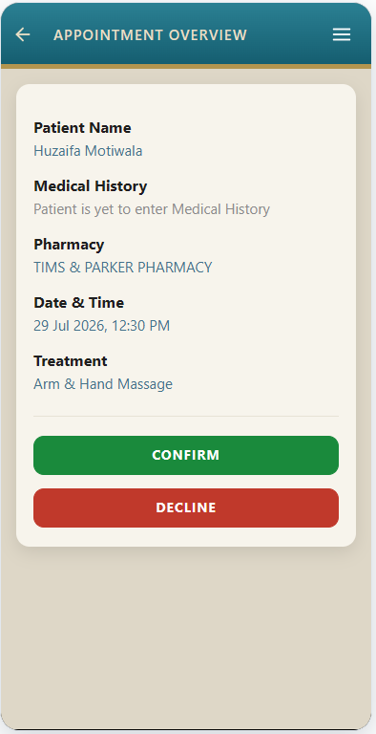
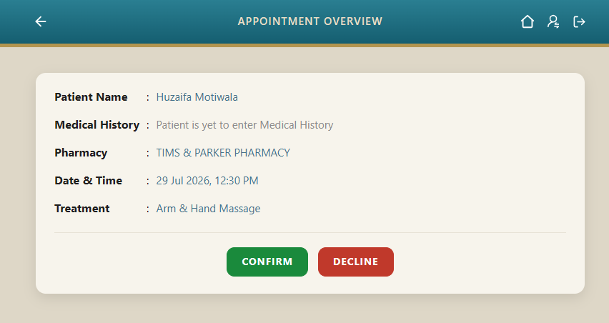
CARD IN RESPONSIVE
In Responsive view, this kind of a layout should appear like this, where the label and the values are intentionally set on separate lines.
In Desktop, they can appear as shown here, i.e. separate columns.
https://specs.pharmacyaesthetics.com/Pharmacy_Wireframes/Pharmacy_Wireframes_Website/partner-practitioner-appointment-overview.html

Slide 18
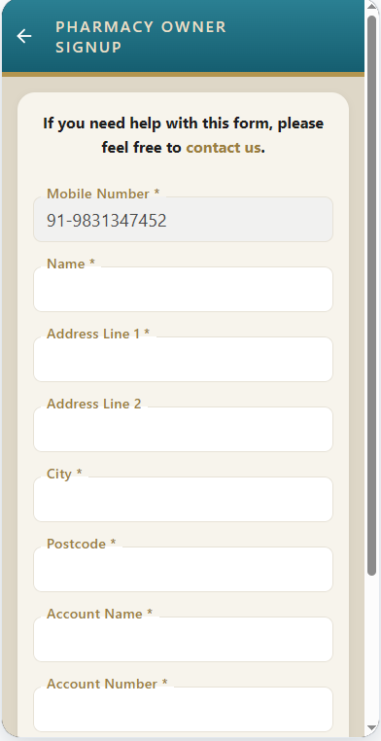
CARD HEADER
This will be the look of a card header across the website
https://specs.pharmacyaesthetics.com/Pharmacy_Wireframes/Pharmacy_Wireframes_Website/partner-owner-signup.html

Slide 19
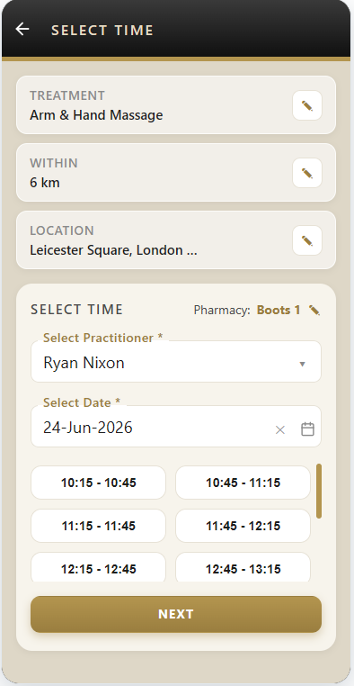
UNIQUE PAGE
This is a little bit of a unique page and its font rules might not apply across the rest of the site. Hence exceptions will need to be made for this page.
https://specs.pharmacyaesthetics.com/Pharmacy_Wireframes/Pharmacy_Wireframes_Website/select-time.html

