Slide 1
Horizontal Lines
Pharmacy Aesthetics

Slide 2
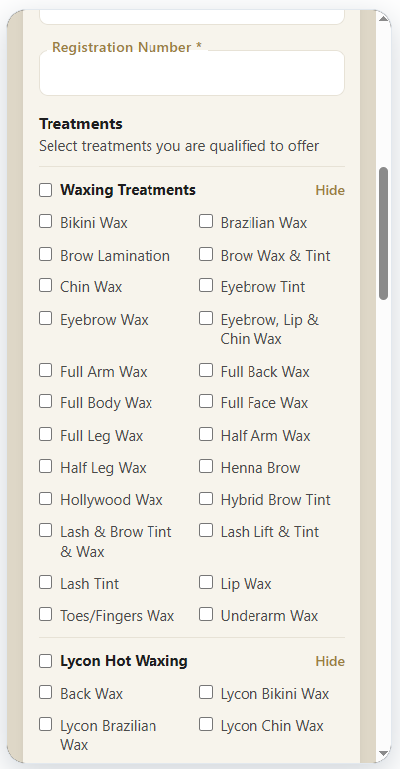
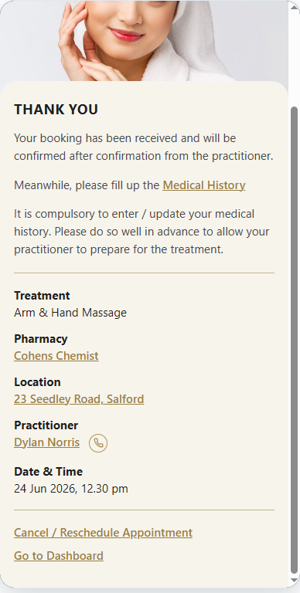
In many pages there are horizontal lines to separate sections. I have given a complete list of these pages (where these lines occur) on subsequent slides. Pl match with the build.
Some lines (like the ones on the left) are thin whereas others (like the ones on the right) are slightly thicker with maybe even a different color.

Slide 3
Link | URL
Signup form - Practitioner | https://specs.pharmacyaesthetics.com/Pharmacy_Wireframes/Pharmacy_Wireframes_Website/partner-practitioner-signup.html
Pharmacy Owner > Add Pharmacy | https://specs.pharmacyaesthetics.com/Pharmacy_Wireframes/Pharmacy_Wireframes_Website/add-pharmacy.html
Pharmacy Owner > View Pharmacy | https://specs.pharmacyaesthetics.com/Pharmacy_Wireframes/Pharmacy_Wireframes_Website/view-pharmacy.html
Pharmacy Owner > Tag Practitioner to Pharmacy | https://specs.pharmacyaesthetics.com/Pharmacy_Wireframes/Pharmacy_Wireframes_Website/partner-owner-tag-practitioner.html
Pharmacy Owner > Tag Prescriber to Pharmacy | https://specs.pharmacyaesthetics.com/Pharmacy_Wireframes/Pharmacy_Wireframes_Website/partner-owner-tag-prescriber.html
Booking - Payment | https://specs.pharmacyaesthetics.com/Pharmacy_Wireframes/Pharmacy_Wireframes_Website/payment.html
Booking - Booking Received | https://specs.pharmacyaesthetics.com/Pharmacy_Wireframes/Pharmacy_Wireframes_Website/confirmation.html
Medical History - Review Alert | https://specs.pharmacyaesthetics.com/Pharmacy_Wireframes/Pharmacy_Wireframes_Website/medical-history-review-alert.html
Medical History - Form | https://specs.pharmacyaesthetics.com/Pharmacy_Wireframes/Pharmacy_Wireframes_Website/medical-history-form.html
Medical History - Thank you (Yet to confirm) | https://specs.pharmacyaesthetics.com/Pharmacy_Wireframes/Pharmacy_Wireframes_Website/medical-history-thanks.html
Medical History - Thank you (confirmed) | https://specs.pharmacyaesthetics.com/Pharmacy_Wireframes/Pharmacy_Wireframes_Website/medical-history-thanks-approved.html
Practitioner - (Appointment Overview) - Yet to enter medical history - Yet to confirm | https://specs.pharmacyaesthetics.com/Pharmacy_Wireframes/Pharmacy_Wireframes_Website/partner-practitioner-appointment-overview.html
Practitioner - (Appointment Overview) - Yet to enter medical history - Confirmed | https://specs.pharmacyaesthetics.com/Pharmacy_Wireframes/Pharmacy_Wireframes_Website/partner-practitioner-appointment-overview-confirmed-yet-to-enter-medical-history.html
Practitioner - (Appointment Overview) - medical history entered - Yet to confirm | https://specs.pharmacyaesthetics.com/Pharmacy_Wireframes/Pharmacy_Wireframes_Website/partner-practitioner-appointment-overview-view-medical-history.html
Practitioner - (Appointment Overview) - medical history entered - Confirmed - Sign medical history | https://specs.pharmacyaesthetics.com/Pharmacy_Wireframes/Pharmacy_Wireframes_Website/partner-practitioner-appointment-overview-sign-medical-history.html
Practitioner - (Appointment Overview) - medical history entered - Confirmed - Signed medical history | https://specs.pharmacyaesthetics.com/Pharmacy_Wireframes/Pharmacy_Wireframes_Website/partner-practitioner-appointment-overview-signed-medical-history.html
Practitioner - (Appointment Overview) - Yet to decline | https://specs.pharmacyaesthetics.com/Pharmacy_Wireframes/Pharmacy_Wireframes_Website/partner-practitioner-decline-appointment-overview.html

Slide 4
Practitioner - (Appointment Overview) - Decline alert | https://specs.pharmacyaesthetics.com/Pharmacy_Wireframes/Pharmacy_Wireframes_Website/partner-practitioner-appointment-overview-decline-alert.html
Practitioner - (Appointment Overview) - Multiple Anti-Wrinkle alert | https://specs.pharmacyaesthetics.com/Pharmacy_Wireframes/Pharmacy_Wireframes_Website/partner-practitioner-appointment-overview-multiple-anti-wrinkle-alert.html
Practitioner > Treatment Details (Generate Invoice) | https://specs.pharmacyaesthetics.com/Pharmacy_Wireframes/Pharmacy_Wireframes_Website/treatment-details.html
Practitioner > Treatment Details (View Unpaid Invoice) | https://specs.pharmacyaesthetics.com/Pharmacy_Wireframes/Pharmacy_Wireframes_Website/treatment-details-sent.html
Practitioner > Treatment Details (View Paid Invoice) | https://specs.pharmacyaesthetics.com/Pharmacy_Wireframes/Pharmacy_Wireframes_Website/treatment-details-paid.html
Treatment Details (View Canceled Unpaid Invoice) | https://specs.pharmacyaesthetics.com/Pharmacy_Wireframes/Pharmacy_Wireframes_Website/treatment-details-canceled-unpaid.html
Treatment Details (View Canceled Paid Invoice) | https://specs.pharmacyaesthetics.com/Pharmacy_Wireframes/Pharmacy_Wireframes_Website/treatment-details-canceled-paid.html
Practitioner > Treatment Details (Hybrid) | https://specs.pharmacyaesthetics.com/Pharmacy_Wireframes/Pharmacy_Wireframes_Website/treatment-details-hybrid.html
Practitioner > Invoice (Generate Invoice) | https://specs.pharmacyaesthetics.com/Pharmacy_Wireframes/Pharmacy_Wireframes_Website/invoice.html
Practitioner > Invoice (Generate Invoice - Confirmation) | https://specs.pharmacyaesthetics.com/Pharmacy_Wireframes/Pharmacy_Wireframes_Website/invoice-sent.html
Practitioner > Invoice (View Unpaid Invoice) | https://specs.pharmacyaesthetics.com/Pharmacy_Wireframes/Pharmacy_Wireframes_Website/unpaid-invoice.html
Practitioner > Invoice (View Paid Invoice) | https://specs.pharmacyaesthetics.com/Pharmacy_Wireframes/Pharmacy_Wireframes_Website/paid-invoice.html
Practitioner > Invoice (View Canceled Unpaid Invoice) | https://specs.pharmacyaesthetics.com/Pharmacy_Wireframes/Pharmacy_Wireframes_Website/canceled-unpaid-invoice.html
Practitioner > Invoice (View Canceled Paid Invoice) | https://specs.pharmacyaesthetics.com/Pharmacy_Wireframes/Pharmacy_Wireframes_Website/canceled-paid-invoice.html
Patient > Pay Invoice (Through PG) | https://specs.pharmacyaesthetics.com/Pharmacy_Wireframes/Pharmacy_Wireframes_Website/patient-pay-invoice.html
Patient > Pay Invoice (Adjust Through Credits) | https://specs.pharmacyaesthetics.com/Pharmacy_Wireframes/Pharmacy_Wireframes_Website/patient-pay-invoice-credits.html
Patient > Pay Invoice (Thank You) | https://specs.pharmacyaesthetics.com/Pharmacy_Wireframes/Pharmacy_Wireframes_Website/patient-thank-you.html

