Slide 1
Label & Values
Pharmacy Aesthetics

Slide 2
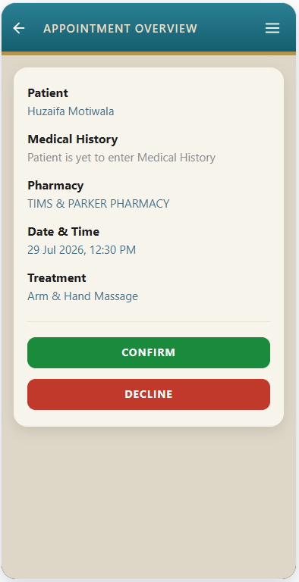
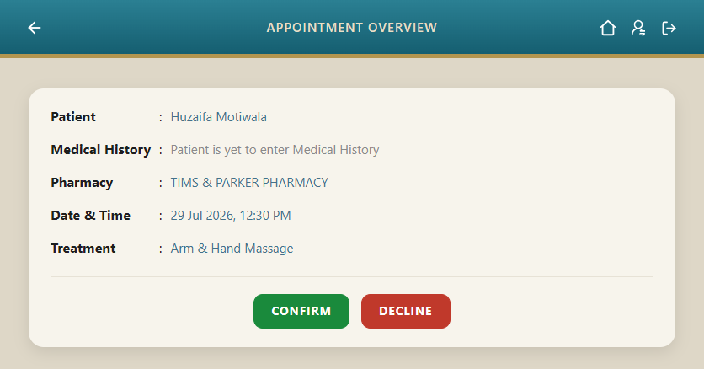
In Responsive mode the label and the value shall come on a separate lines.
And there will be no semi-colon after the label.
In Desktop mode the label and the value shall come side-by-side.
And there will be a semi-colon after the label.

