Slide 1
Page Width
Pharmacy Aesthetics

Slide 2
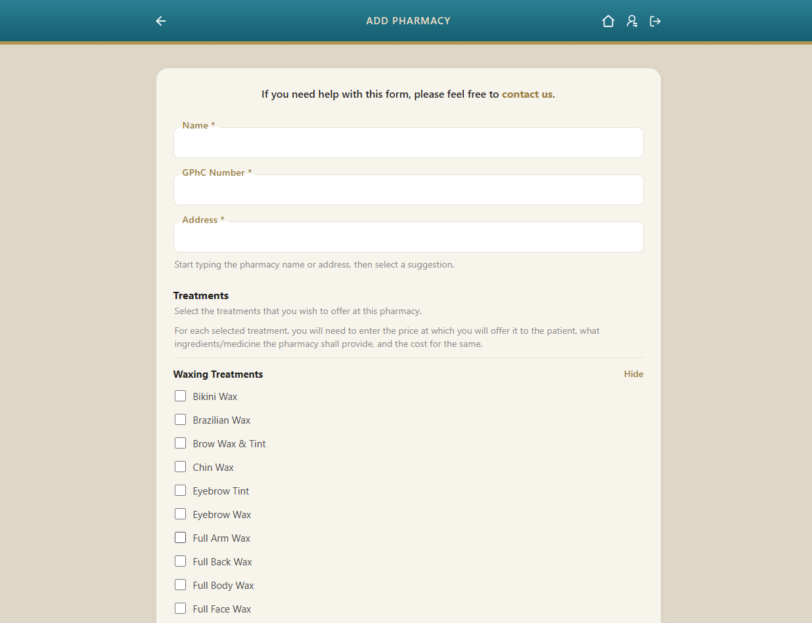
This is how a typical page is supposed to appear on desktop.
The width of the card (in the body) is 768 px and is perfectly aligned with the Back button and the Icons in the header.
768 px

Slide 3
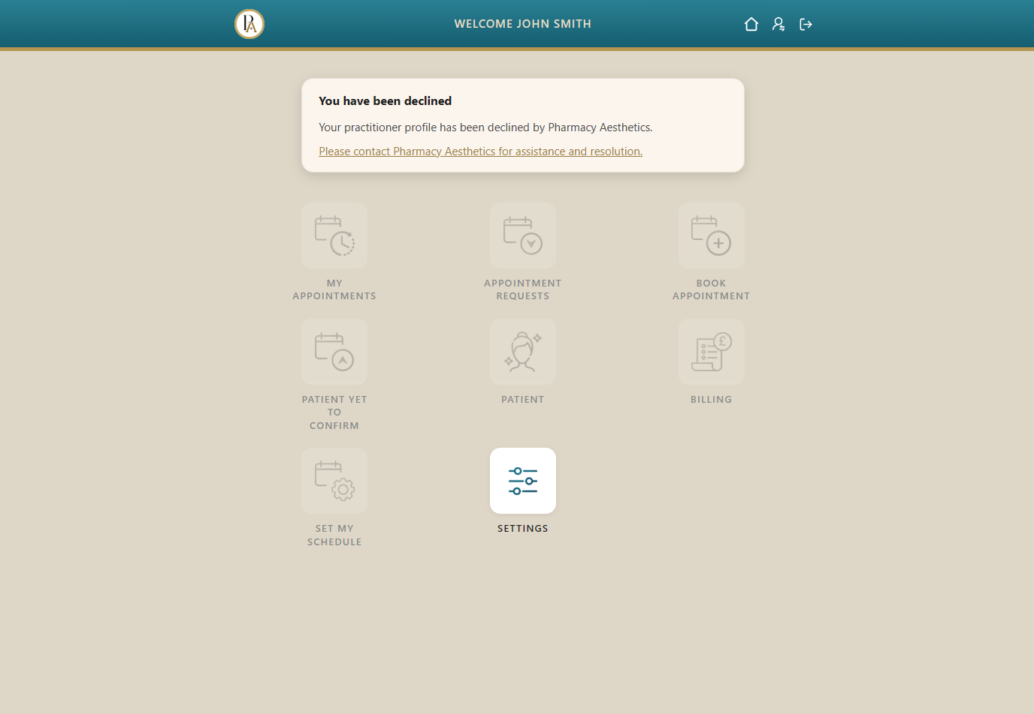
Similarly, on the Dashboard pages (where the logo appears instead of the back button), the left-edge of the logo will be where the extreme-left point of the Back arrow was.
Pl note, on Dashboard pages there is no card and so this is how the page will appear.
768 px

Slide 4
On subsequent slides are the pages where the 768 px card width does not apply and neither does the header width

Slide 5
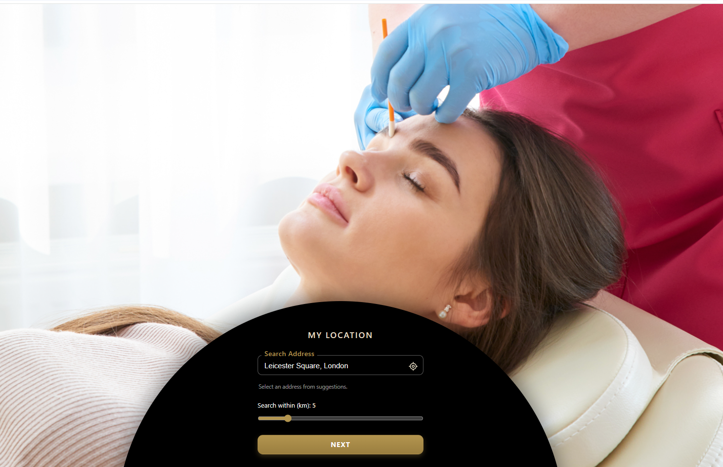
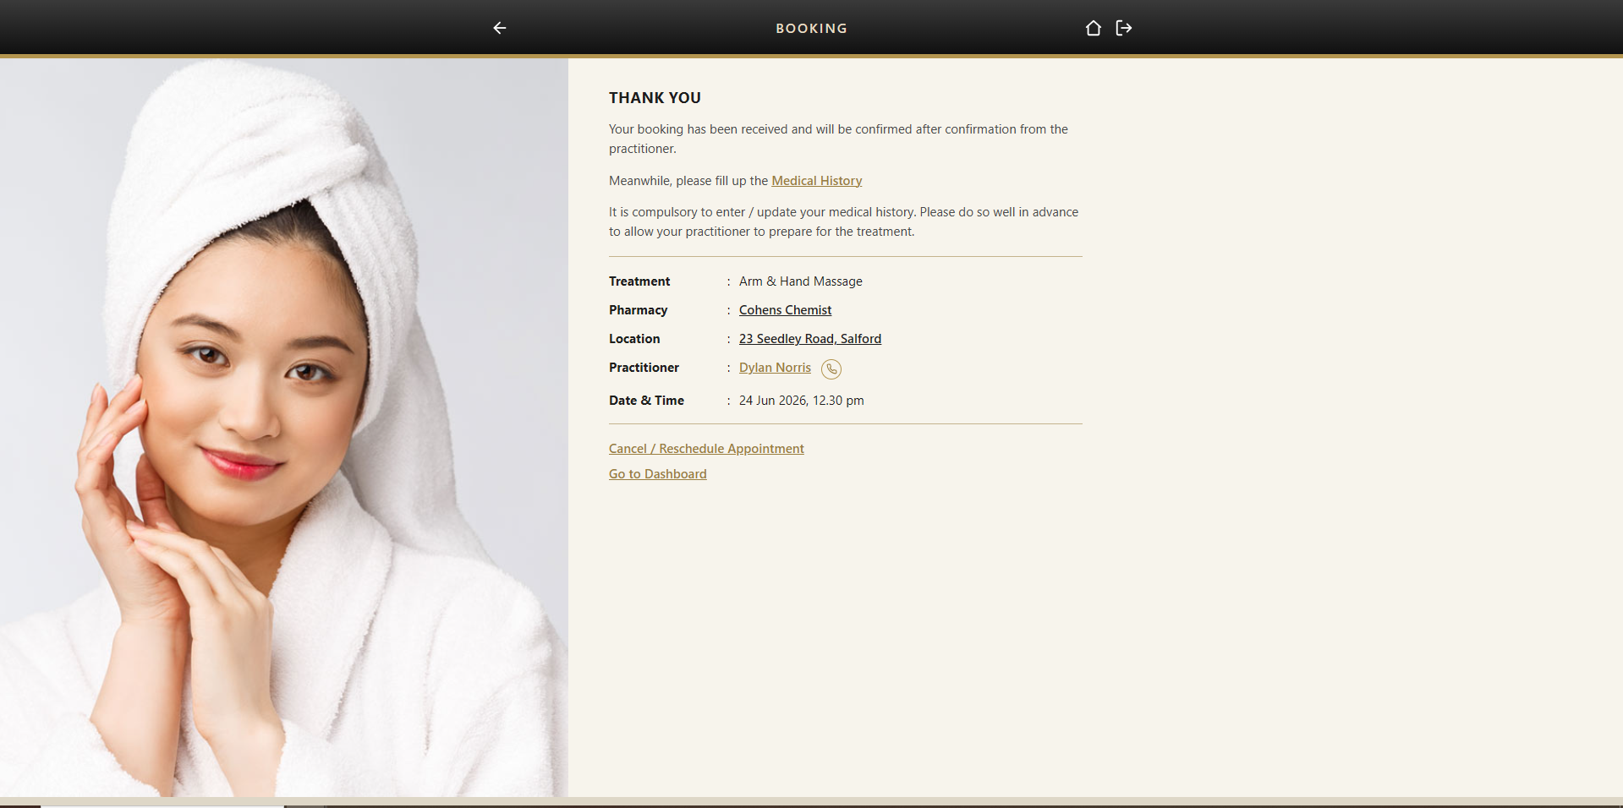
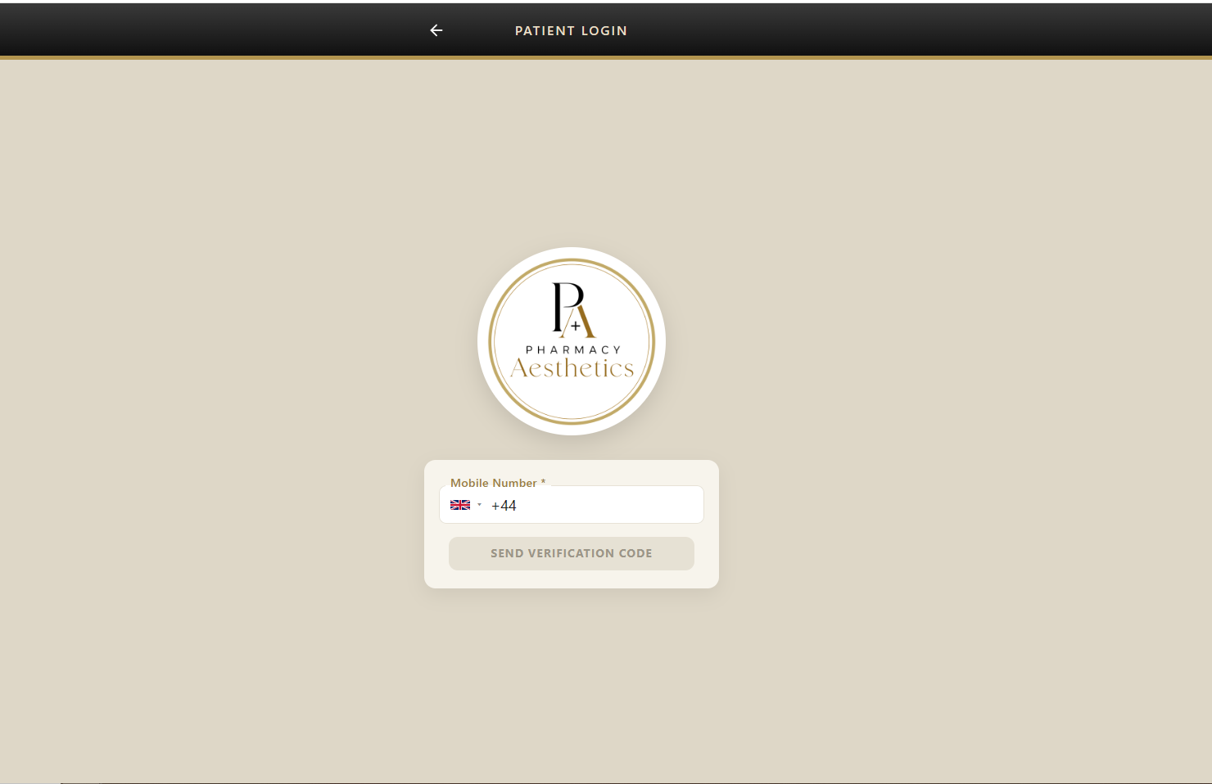
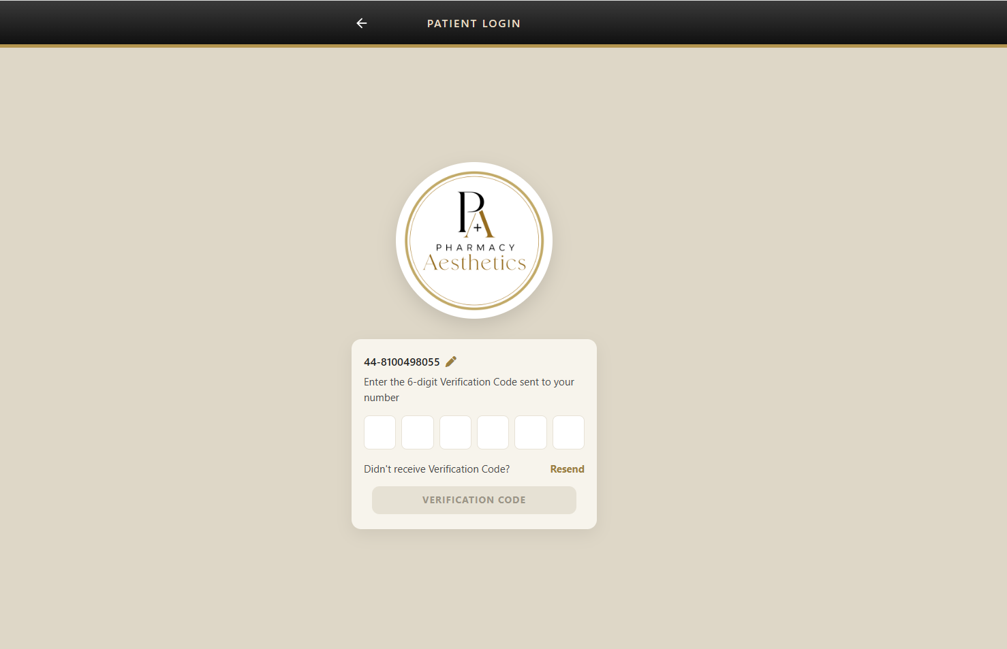

Slide 6
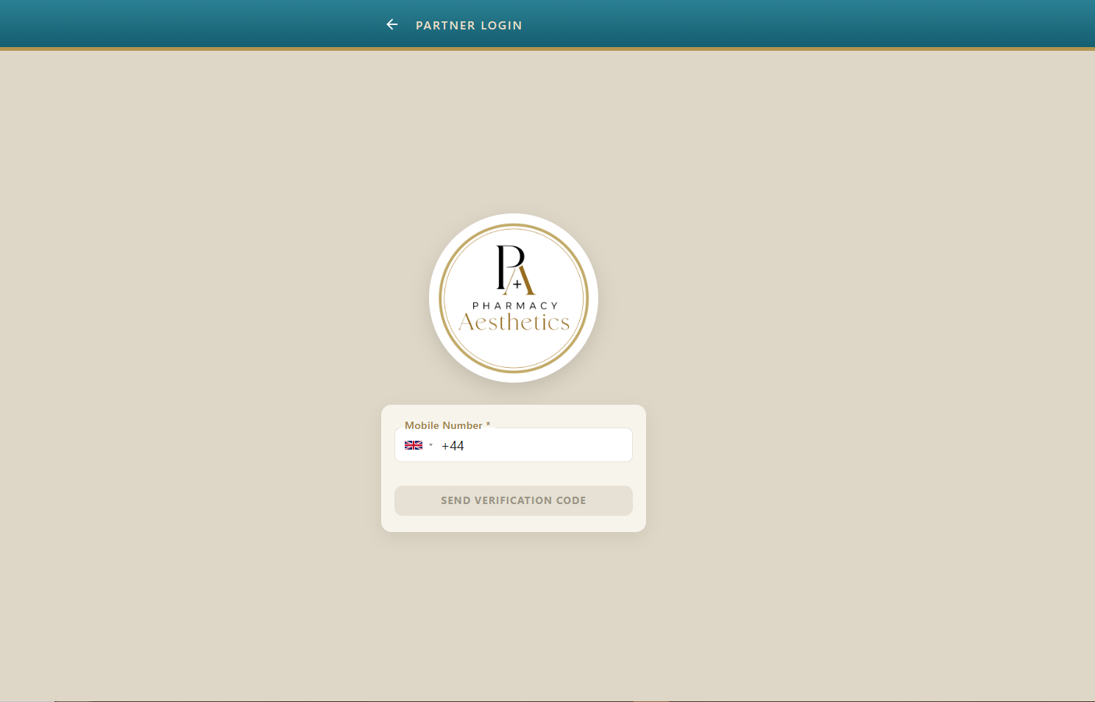
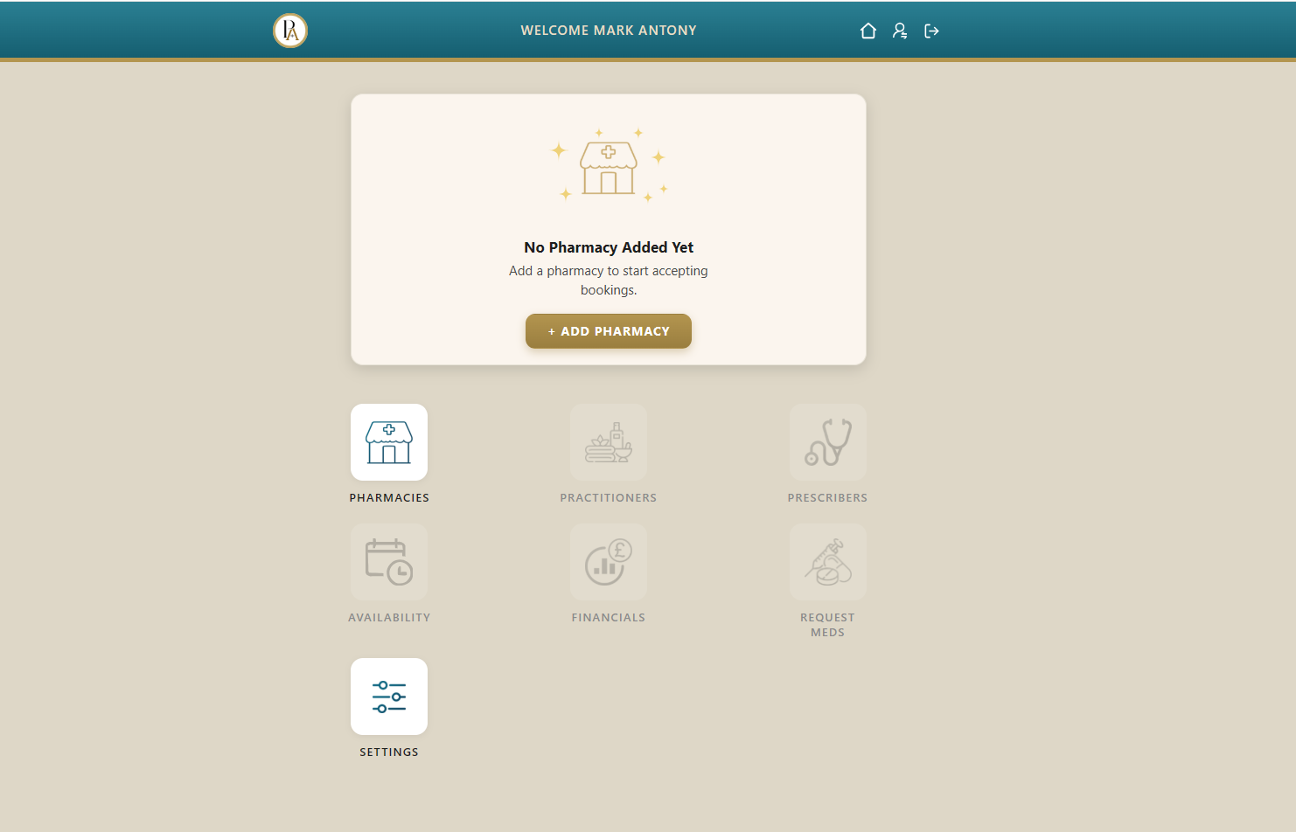
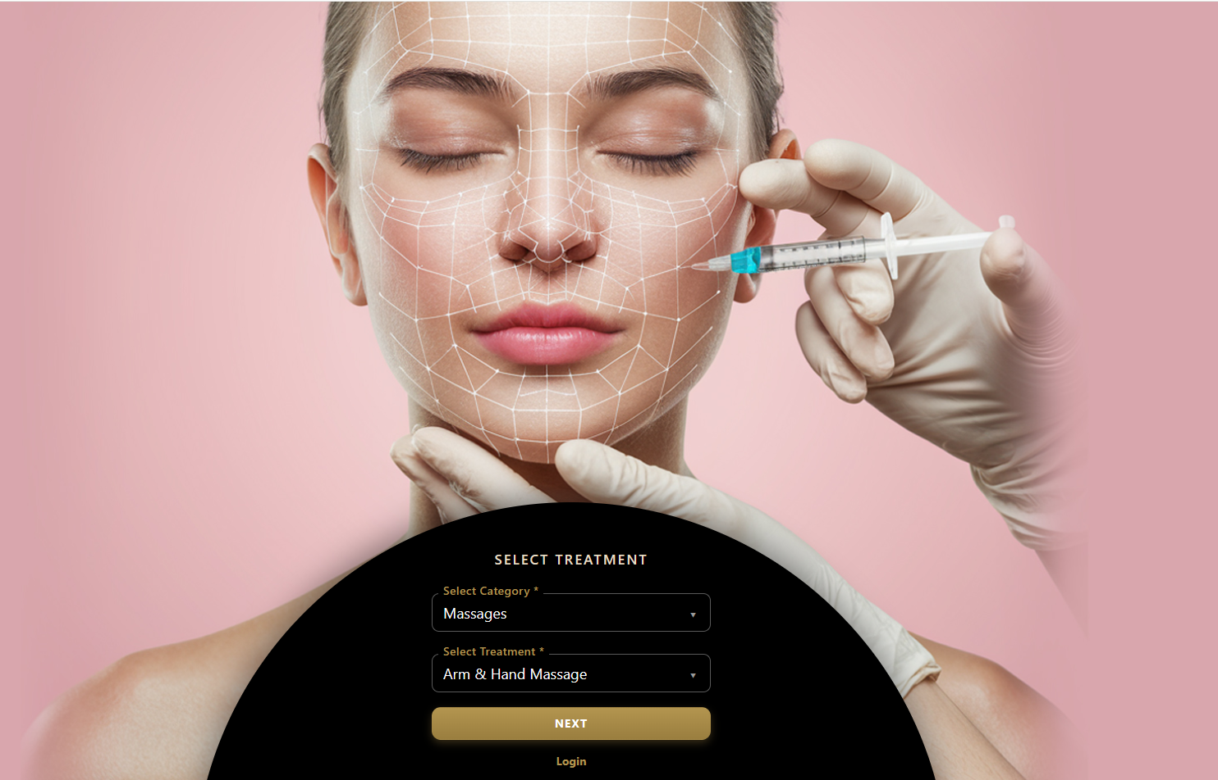


Slide 7

